Slide 1
Supervised-Real-Estate-Across-the-united-states

Slide 2
Real Estate Across the United States (REXUS) is the primary tool used by PBS to track and manage the government's real property assets and to store inventory data, building data, property type , and lease information. STAR manages aspects of real property space management, including identification of all building space and daily management of 22,000 assignments for all property to its client Federal agencies. This data set contains PBS building inventory that consists of both owned and leased buildings with active and excess status.

Slide 3
My link tableau datasheet
My link excel dataset

Slide 4
Summary
This is the dataset that we have first columns as the building city and second columns building state this are all which is an united state and this are united state related state.
And the building Status which is herded where it is active, decommissioned or excess .
And finally property types building structured than total parking spaces which is right form 0 to 6198.
And finally you have the next column which is the list and on the form this data we have see that we heavy in faces on the dimensions that we have so we have and all 5 dimensions and just one major are so there is a lot of possibility that one can have and one can developed so I have developed around 5 different questions.

Slide 5
Questions
1) Which property type has more active Parking ?
2) How’s the distribution of parking by building status and building state ?
3) How’s is the overall situation of total parking spaces by building state ?
4) In which building parking situation is in excess-put it in a order ?
5) In which type of property parking space is in excess ?

Slide 6
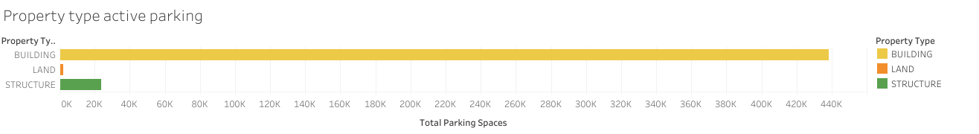
Which property type has more active Parking ?

Slide 7
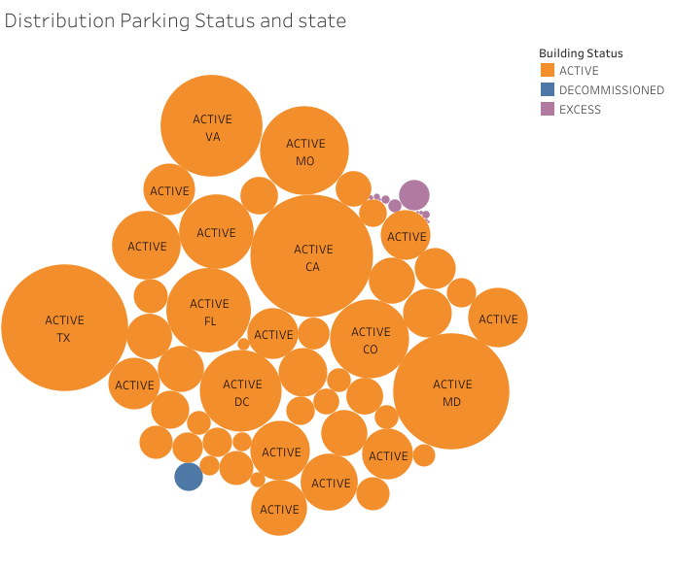
How’s the distribution of parking by building status and building state ?

Slide 8
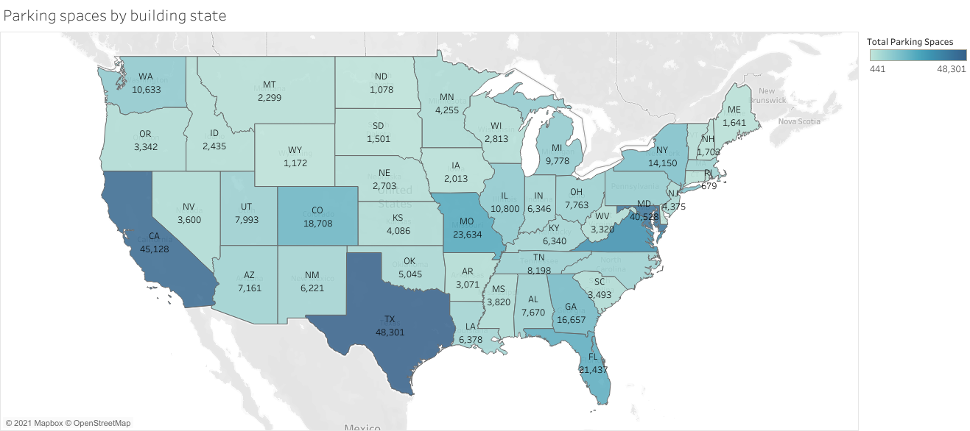
How’s is the overall situation of total parking spaces by building state ?

Slide 9
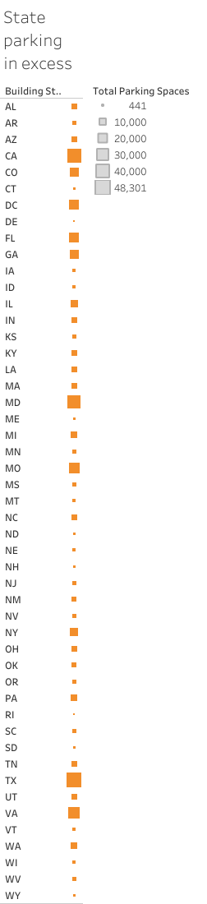
In which building parking situation is in excess-put it in a order ?

Slide 10
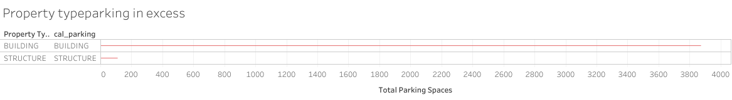
In which type of property parking space is in excess ?

Slide 11
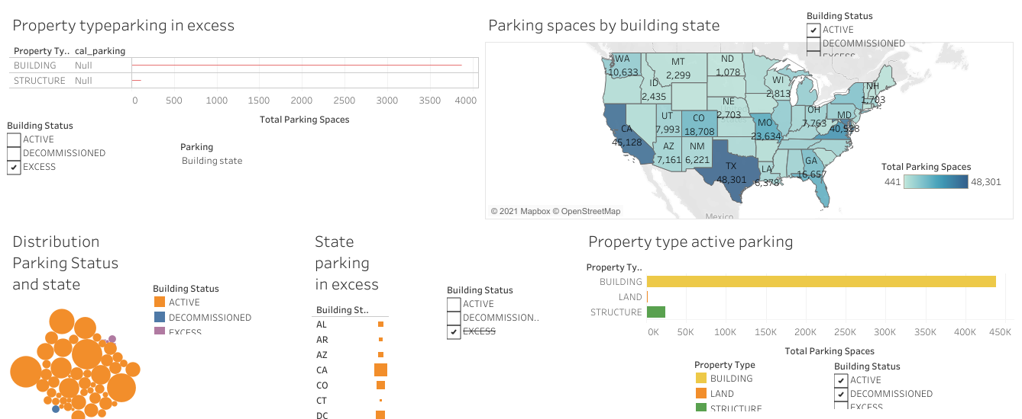
Dashboard

Slide 12
Conclusions
The Commercial Real Estate Investment Market is a complex system of firms based in different sectors of the industry. The future of companies in this sector are most directly affected and tied to changes in global economic conditions. Depending on what the firms focus on, from Land and Development, Retail Shopping Centers, Industry/Office Space, or Apartments and Multi-family homes, there are many factors affecting their strategy, overall performance, and future.

Slide 13
My video link

